Slide 1
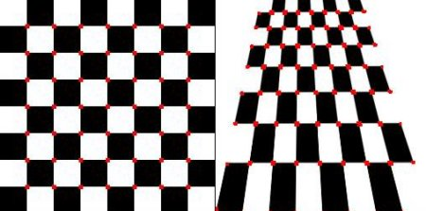
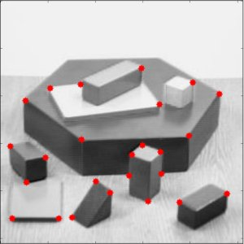
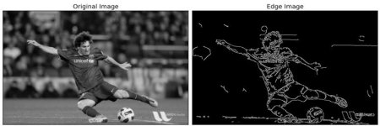
F-1 Validation Score of 0.86 with 0.45 threshold
Features added:
Harris Corner Detector
Canny Edge Detector
Shi-Tomasi Corner Detector

